Slide 1
HELP – Identifying the most needful countries
-Archit srivastava

Slide 2
The Problem
We have been able to raise around $ 10 million.
Now we want to suggest the CEO to decide how to use this money strategically and effectively. The significant issues that come while making this decision are mostly related to choosing the countries that are in the direst need of aid.
And this is where this report comes in as a saviour.
We have categorised the countries using some socio-economic and health factors that determine the overall development of the country.
We will suggest the countries which the CEO needs to focus on the most.

Slide 3
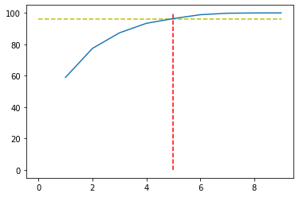
Results of pca
From the scree plot it can be clearly seen that with 5 PC's we are reaching ~96% information.
We tried to do outlier analysis but that would have removed the countries needing most help like Nigeria which has very low child_mortality rate

Slide 4
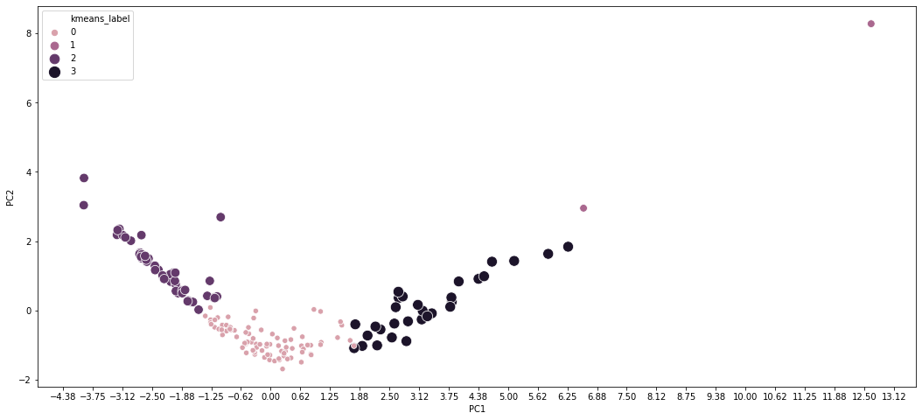
The groups of countries
We found 4 clusters of countries as shown

Slide 5
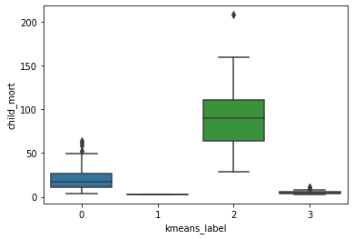
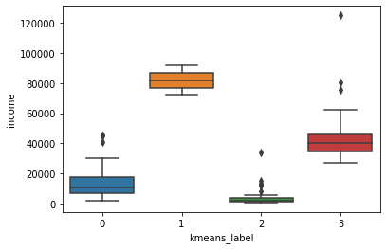
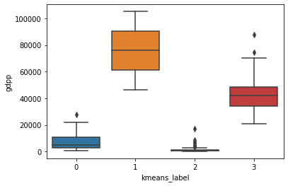
Groupwise stats
Stats like gdpp, child_mortality and income were analysed
As we can see groups 0 and 2 are consistent low performers in all three departments
Thus we need to focus on these groups most importantly group 2

Slide 6
Final List of countries
'Congo, Dem. Rep.',
'Liberia',
'Burundi',
'Niger',
'Central African Republic',
'Mozambique',
'Malawi',
'Guinea',
'Togo',
'Sierra Leone',
'Haiti',
'Chad',
'Mali',
'Nigeria',
'Angola',
'Burkina Faso',
'Madagascar',
'Eritrea'

Slide 7
Analysis and recommendations
Analysis
Main problem is health conditions
This leads to low income, and low education
Finally this leads to low gdpp overall
Recommendations
More spending in early days in health
Focus on child mortality rate improvement
Skilling the population for better incomes
These are the areas – Health, Education and skill development

